Slide 1
Micro:Bit Lock!
Final Micro:Bit section

Slide 2
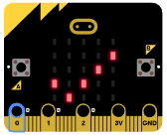
Get the .hex file
In this section you will be given a .hex file that contains a locked program.
You will not be given any hints or clues.
You have unlocked the lock when your screen looks like this:

Slide 3
Having trouble?
Grab a piece of paper and write down the answers to these questions:
What do you notice first?
What is happening?
Is there a loop?
Do any inputs effect the Micro:Bit?

Slide 4
Once you think you know the secret?
Go to the instructor and unlock your Micro:Bit 3 times. If you are able to unlock your Micro:Bit 3 times you will be given the Source Code.
Modify the source code to you liking. Create your own lock.

